Slide 1


CSS Flexbox
Notes:
Get connected
Self introduction
Engagement questions
Will have gifts if you can answer questions
——
How many of you didn’t know HTML/CSS before?
How many of you already know HTML/CSS?
How many of you never heard about HTML/CSS?

Slide 2


Slide 3
Agenda
Common CSS Properties
Float
Flexbox
Q & A

Slide 4
Common CSS Properties

Slide 5
Practice
Use some common properties

Slide 6
CSS Float
Notes:
Bo tri cac doi tuong
Dung lam bai bao,

Slide 7
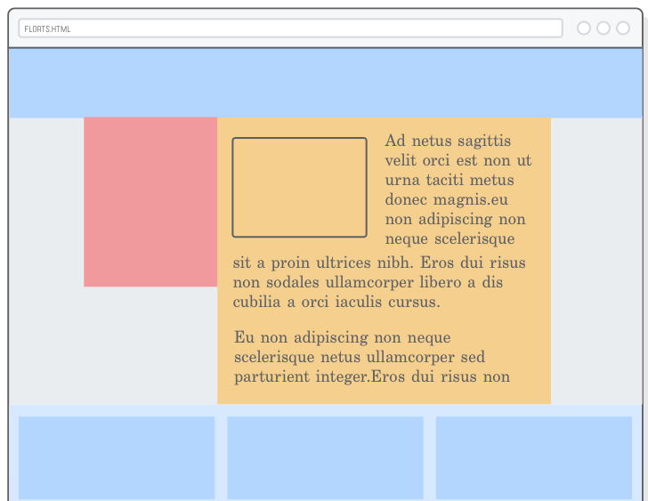
Magazine layout

Slide 8
Practice
CSS Float

Slide 9
CSS Flexbox
Flexible box

Slide 10
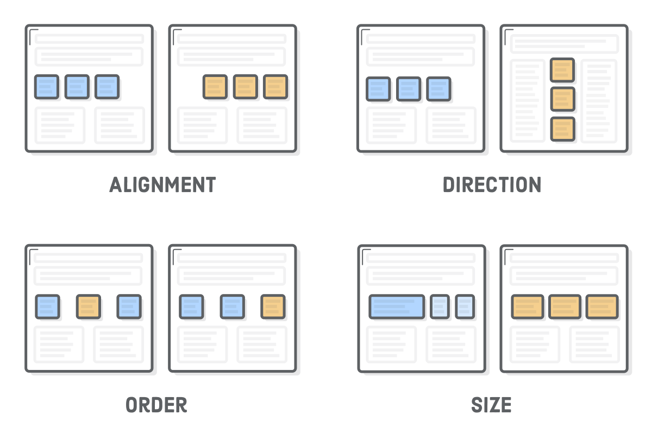
Why flexible?
Notes:
Thay doi thu tu, canh le, thay doi kich thuoc

Slide 11
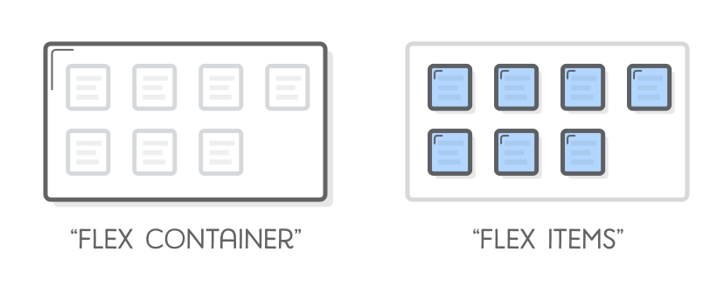
Flex container & items

Slide 12
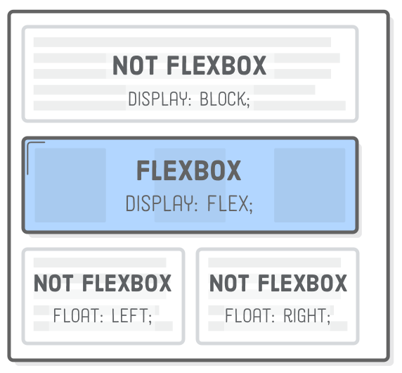
Flex container
Notes:
Chi dinh doi tuong nao do la container

Slide 13
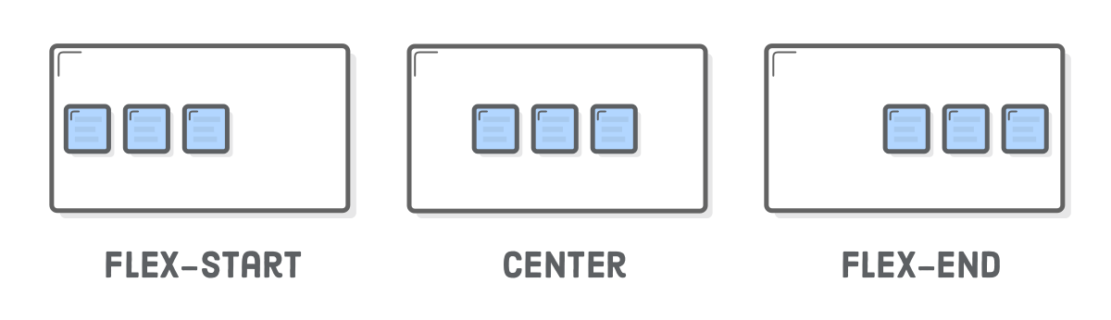
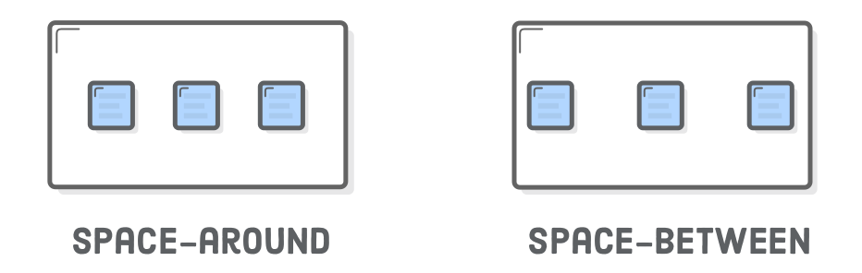
Horizontal alignment (justify-content)
Notes:
Display:flex;
Justify-content:FLEX-START;

Slide 14
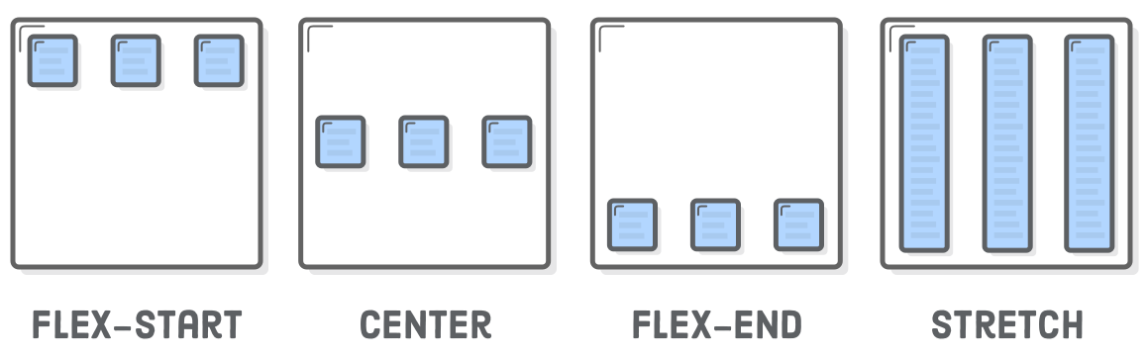
Vertical alignment (align-items)
Notes:
Stretch : keo dan tat ca con = chieu cao cha

Slide 15
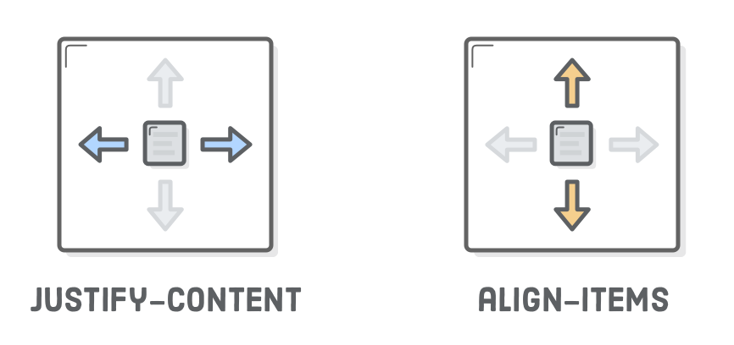
Horizontal & Vertical alignment

Slide 16
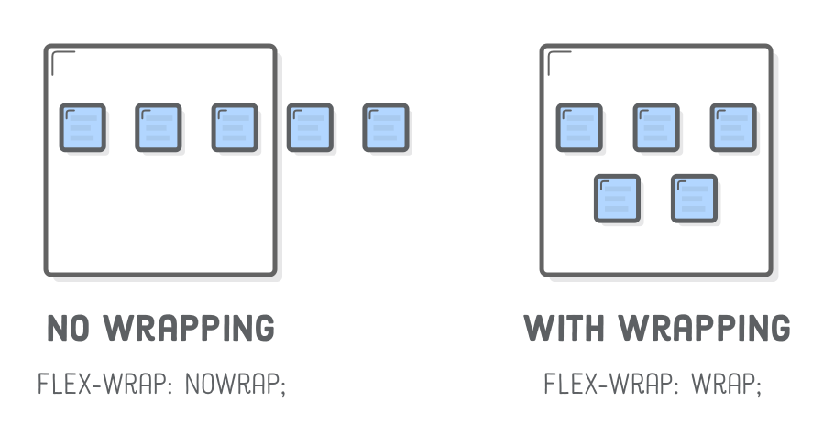
Wrapping

Slide 17
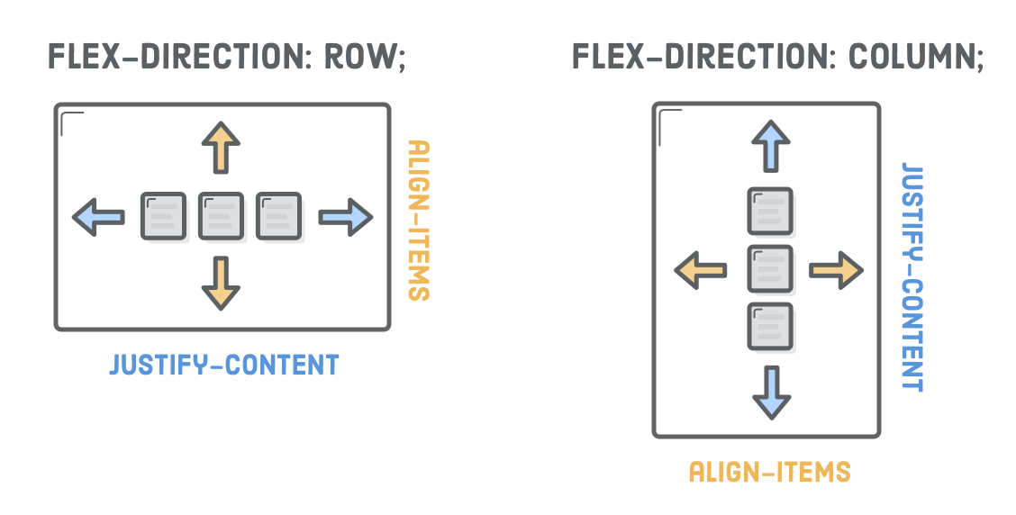
Flex direction

Slide 18
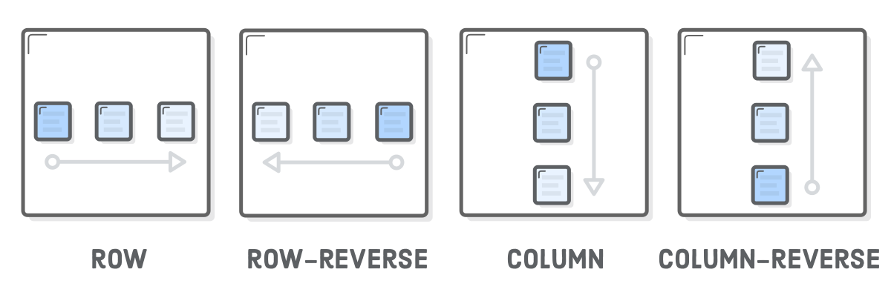
Flex container order

Slide 19
Flex item
Direct children of flex container

Slide 20
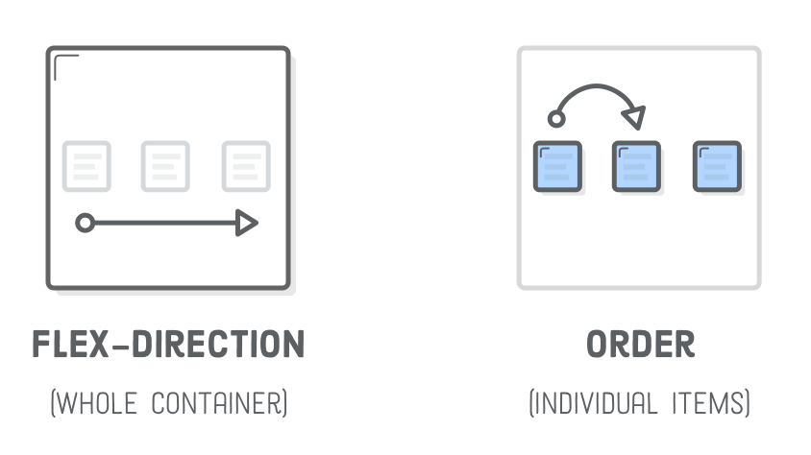
Flex item order
Notes:
Neu order = sau thi so sanh theo html
Dung cho mobile hoac web may tinh

Slide 21
Flex item alignment (align-self)
Notes:
Align-self all right align item xuong

Slide 22
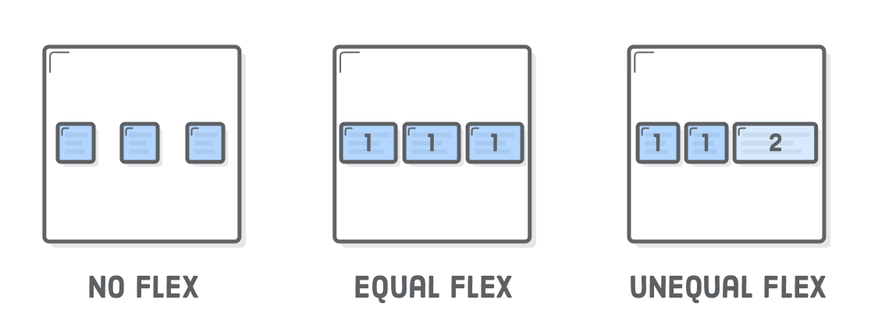
Flex item’s width

Slide 23
Practice
CSS Flexbox

Slide 24


Slide 25

Thank You And see you ;)

